Slide 1

ARTIFICIAL INTELLIGENCE
MACHINE
LEARNING
Supervised Learning & Logistic Regression
Unsupervised Learning & K-Means Clustering
WEEK 6 | LECTURES 11-12

Slide 2
LEARNING ROADMAP
Table of Contents
01
02
03
04
05
Introduction to Machine Learning
Supervised Learning
Logistic Regression
Unsupervised Learning
K-Means Clustering
Foundations, paradigms, and the ML workflow
Learning from labeled data: classification and regression
From linear predictions to probabilistic classification
Discovering hidden patterns in unlabeled data
The most popular clustering algorithm
02

Slide 3

01
INTRODUCTION TO MACHINE LEARNING
Foundations, paradigms, and the ML workflow

Slide 4
01 | INTRODUCTION
What is Machine Learning?
"Field of study that gives computers the ability to learn without being explicitly programmed."
— Arthur Samuel, 1959
THE ML CONCEPT
Data
Key Characteristics
Learns from data — improves performance through experience
ML Algorithm
feedback
Improves over time — more data leads to better accuracy
Generalizes — applies learning to unseen situations
Prediction
Real-World Examples
ML is a subset of AI that enables systems to automatically learn and improve from experience without being explicitly programmed for every scenario.
Spam filtering — classifies emails as spam or legitimate
Recommendation systems — Netflix, Amazon suggest content
Voice assistants — Siri, Alexa understand speech
Autonomous vehicles — self-driving cars perceive environment
04

Slide 5
01 | INTRODUCTION
The Three Paradigms of Machine Learning
Supervised Learning
Unsupervised Learning
Reinforcement Learning
Learns from labeled data where each input is paired with a known output.
The model learns a mapping function f: X → y by comparing predictions against correct answers.
Types:
Classification (discrete output)
Regression (continuous output)
Discovers hidden patterns in unlabeled data without predefined targets.
The algorithm finds structure independently — like sorting books without labels.
Types:
Clustering
Dimensionality Reduction
Association Rules
An agent learns optimal behaviors through trial-and-error with an environment.
Receives rewards or penalties to guide learning.
Key concepts:
Agent & Environment
Reward/Penalty signals
Policy optimization
Note: Modern approaches often blend these paradigms. Semi-supervised learning combines small labeled datasets with large unlabeled data. Self-supervised learning generates training signals from raw data.
05

Slide 6
01 | INTRODUCTION
Supervised vs. Unsupervised Learning
Dimension | Supervised Learning | Unsupervised Learning
Input Data | Labeled data (input + known output) | Unlabeled data (only input features)
Goal | Predict outcomes or classify data | Discover hidden patterns and structures
Evaluation | Accuracy, Precision, Recall, RMSE, F1 | Silhouette score, Elbow method, Expert validation
Complexity | Less complex — clear guidance from labels | More complex — requires interpretation
Applications | Email filtering, sentiment analysis, medical diagnosis | Customer segmentation, anomaly detection, pattern discovery
When to Use Which?
Use Supervised Learning when you have labeled data and need precise predictions (e.g., predicting house prices, classifying diseases). Use Unsupervised Learning when exploring unknown structure or when labeling is impractical (e.g., customer segmentation, anomaly detection).
06

Slide 7
01 | INTRODUCTION
The Machine Learning Workflow
1
Data Collection
Gather relevant, representative data for the problem at hand
ITERATIVE NATURE OF ML
The ML workflow is not linear — it is an iterative cycle:
1. Results from evaluation feed back into preprocessing or training
2. Models are refined based on performance feedback
3. Hyperparameters are tuned iteratively
4. New data triggers retraining cycles
Key principle: A deployed model requires continuous monitoring. Data distributions change over time (concept drift), and models must be updated to maintain accuracy.
2
Data Preprocessing
Clean, normalize, handle missing values, feature engineering
3
Train-Test Split
Typically 80% training, 20% testing — ensure unbiased evaluation
4
Model Training
Feed training data to algorithm, learn patterns and relationships
5
Model Evaluation
Test on unseen data, measure performance with appropriate metrics
6
Deployment & Monitoring
Deploy model to production, track performance over time
07

Slide 8
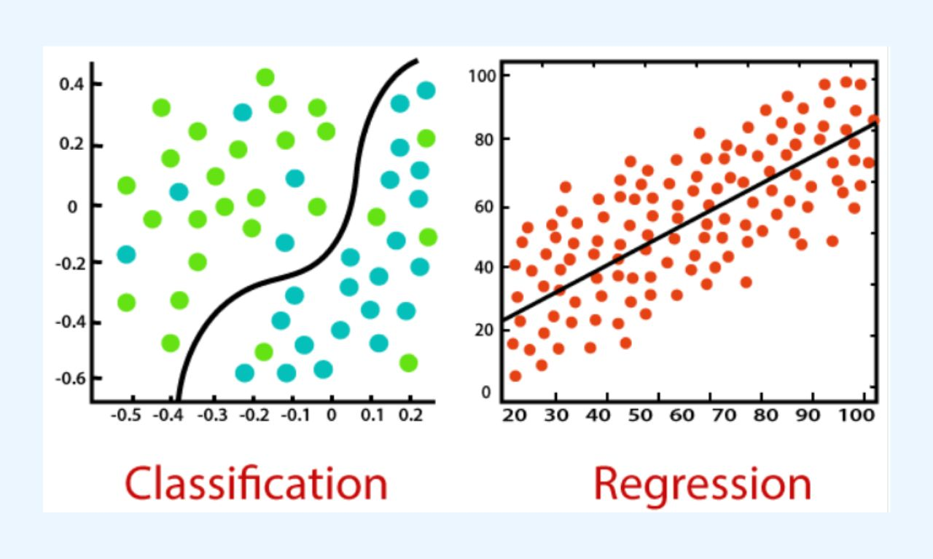
02
SUPERVISED LEARNING
Learning from labeled data: classification and regression

Slide 9
02 | SUPERVISED LEARNING
Introduction to Supervised Learning
Uses labeled datasets where each input X is paired with a known output y. The model learns a mapping function: f: X → y
HOW SUPERVISED LEARNING WORKS
Labeled Training Data
Two Main Problem Types
Classification
Learning
Algorithm
Output is a categorical variable. Goal: assign inputs to predefined classes.
Examples: spam detection, image recognition, disease diagnosis
Trained Model
Regression
New Input X
Output is a continuous variable. Goal: predict numeric values.
Examples: house prices, stock forecasting, temperature prediction
Prediction ŷ
The model generalizes from training examples to make accurate predictions on data it has never seen before.
09

Slide 10
02 | SUPERVISED LEARNING
Classification vs. Regression
CLASSIFICATION
REGRESSION
Output: Categorical variable (discrete classes)
Goal: Assign inputs to predefined classes
Common Algorithms:
Logistic Regression
Decision Trees
Support Vector Machine (SVM)
Naive Bayes
K-Nearest Neighbors (KNN)
Random Forests
Examples:
Email spam detection
Medical diagnosis
Image recognition
Output: Continuous variable (numeric values)
Goal: Predict numeric quantities
Common Algorithms:
Linear Regression
Polynomial Regression
Ridge Regression
Lasso Regression
Support Vector Regression
Examples:
House price prediction
Stock price forecasting
Weather prediction
Key difference: Classification predicts categories (spam/not spam); Regression predicts quantities (house price = $350,000).
10

Slide 11
02 | SUPERVISED LEARNING
Common Supervised Learning Algorithms
Algorithm | Description | Best For
Linear Regression | Predicts continuous values using a linear relationship between features and target | Simple prediction tasks with linear relationships (house prices)
Logistic Regression | Predicts binary outcomes using the sigmoid function; outputs probabilities | Binary classification (spam detection, disease risk)
Decision Trees | Tree-like structure where each node represents a decision, leaves represent outcomes | Interpretable models, mixed data types
Random Forests | Ensemble of multiple decision trees; improves accuracy and reduces overfitting | Complex problems requiring robust performance
SVM | Separates data into classes using a hyperplane boundary; support vectors define margin | High-dimensional data, clear margin separation
K-Nearest Neighbors | Predicts based on the K closest data points using distance metrics | Small datasets, simple decision boundaries
Naive Bayes | Probabilistic classifier based on Bayes' Theorem; assumes feature independence | Text classification, large feature spaces
Gradient Boosting | Builds models sequentially, correcting errors of previous models | Competitive accuracy, structured/tabular data
11

Slide 12
02 | SUPERVISED LEARNING
Linear Regression: The Foundation
$$y=β_{0}+β_{1}x_{1}+β_{2}x_{2}+...+β_{n}x_{n}$$
Goal: Find coefficients (β) that minimize the sum of squared errors between predicted and actual values.
Optimization:
Ordinary Least Squares (OLS) — analytical solution
Gradient Descent — iterative optimization
Assumptions:
Linear relationship between features and target
Independent, normally distributed errors
Evaluation Metrics
MSE — Mean Squared Error
Average of squared differences
RMSE — Root Mean Squared Error
Square root of MSE
R² — Coefficient of Determination
Proportion of variance explained
Limitations: Sensitive to outliers, assumes linearity, may underfit complex relationships. These limitations motivate more advanced approaches like Logistic Regression.
12

Slide 13
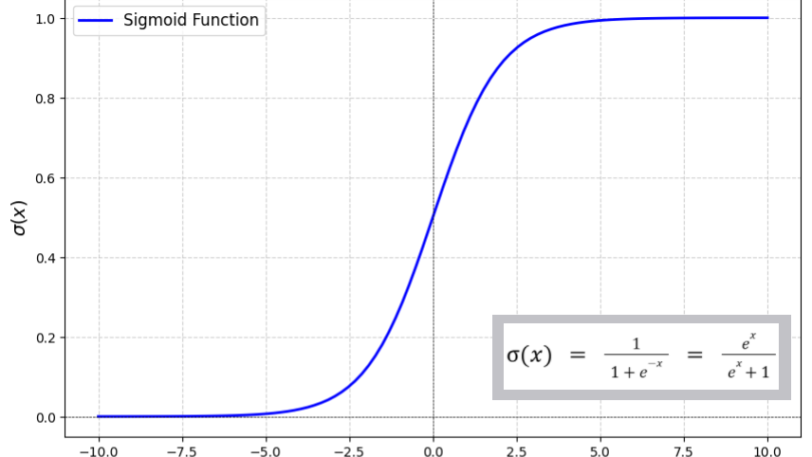
03
LOGISTIC REGRESSION
From linear predictions to probabilistic classification

Slide 14
03 | LOGISTIC REGRESSION
What is Logistic Regression?
Despite its name, Logistic Regression is a classification algorithm — not a regression algorithm. It predicts the probability of a binary outcome.
LOGISTIC VS LINEAR
Linear Regression
How It Works
• Predicts continuous values
• Output range: (-∞, +∞)
• Used for regression tasks
Extends linear regression by applying the sigmoid function
Constrains output between 0 and 1
Output is interpreted as probability: P(y=1|X)
If P ≥ 0.5 → predict Class 1; otherwise Class 0
Logistic Regression
• Predicts probabilities
• Output range: (0, 1)
• Used for classification tasks
Applications
Advantages
Key insight: The sigmoid function transforms the linear output into a probability, making logistic regression ideal for binary classification problems.
This same sigmoid is now a common activation function in neural networks.
Medical diagnosis — disease risk prediction
Simple and interpretable
Computationally efficient
Works well with linearly separable data
Provides probability estimates
No hyperparameter tuning needed
Credit scoring — loan default prediction
Marketing — customer churn prediction
14

Slide 15
03 | LOGISTIC REGRESSION
The Sigmoid Function
$$σ(z)=\frac{1}{1+e^{−z}}$$ where $$z=β_{0}+β_{1}x_{1}+...+β_{n}x_{n}$$
Key Properties
Range: Output always in (0, 1)
Shape: S-shaped (sigmoid) curve
Center: σ(0) = 0.5 (decision boundary)
As z → +∞: σ(z) → 1
As z → -∞: σ(z) → 0
CONNECTION TO DEEP LEARNING
The sigmoid function is the core activation that transforms linear output into probability. This same function is now a common activation function in neural networks, connecting classical machine learning to deep learning. Understanding logistic regression provides intuition for how neurons in neural networks make decisions.
15

Slide 16
03 | LOGISTIC REGRESSION
Decision Boundary
The decision boundary separates data points into different classes. It occurs where P(y=1|X) = 0.5, which corresponds to z = 0.
Linear Decision Boundary
Non-Linear Decision Boundary
When features have a linear relationship with the log-odds:
2D: straight line
3D: plane
Higher D: hyperplane
Created by adding polynomial features:
Add x₁², x₂², x₁x₂ terms
Captures more complex patterns
Risk of overfitting with high degrees
16

Slide 17
03 | LOGISTIC REGRESSION
Cost Function & Optimization
Why not MSE? Mean Squared Error creates a non-convex cost surface with many local minima for logistic regression.
KEY HYPERPARAMETERS
Learning Rate (α)
Log Loss (Cross-Entropy Loss)
Step size for gradient descent. Too large: divergence. Too small: slow convergence.
$$J(β)=−\frac{1}{m}∑_{i=1}^{m}[y^{(i)}log⁡({\overset{^}{y}}^{(i)})+(1−y^{(i)})log⁡(1−{\overset{^}{y}}^{(i)})]$$
Number of Iterations
Properties of Log Loss:
Convex — guarantees global minimum
Heavily penalizes confident wrong predictions
Natural fit for probabilistic outputs
Maximum training epochs. Early stopping can prevent overfitting.
Regularization (L1 / L2)
Penalty term to prevent overfitting. L1 = feature selection, L2 = weight decay.
Gradient Descent
$$β_{j}:=β_{j}−α⋅\frac{∂J}{∂β_{j}}$$
Threshold
Default 0.5 for binary classification. Can be tuned for precision-recall tradeoff.
Where α = learning rate. Iteratively updates coefficients to minimize cost.
Regularization strength (λ) controls the bias-variance tradeoff.
17

Slide 18
03 | LOGISTIC REGRESSION
Logistic Regression: Practical Example
Scenario: Predicting university admission based on two exam scores (0-100 scale)
1. Dataset
Historical applicant data with features: Exam 1 Score, Exam 2 Score and label: Admitted (0 or 1)
MODEL OUTPUT INTERPRETATION
Coefficients (β) indicate feature importance
Larger |β| = greater influence on probability
2. Training
Fit logistic regression model to learn the decision boundary separating admitted vs. rejected.
Positive β: higher feature value → higher P(y=1)
Negative β: higher feature value → lower P(y=1)
3. Prediction
For a new applicant with scores (75, 80):
P(admitted) = σ(β₀ + β₁·75 + β₂·80)
Evaluation Metrics:
Accuracy, Precision, Recall, F1-Score, AUC-ROC
4. Decision
If P ≥ 0.5 → Admitted
If P < 0.5 → Not Admitted
Why Logistic Regression here?
Simple, fast, interpretable — ideal baseline classifier for admission prediction.
18

Slide 19
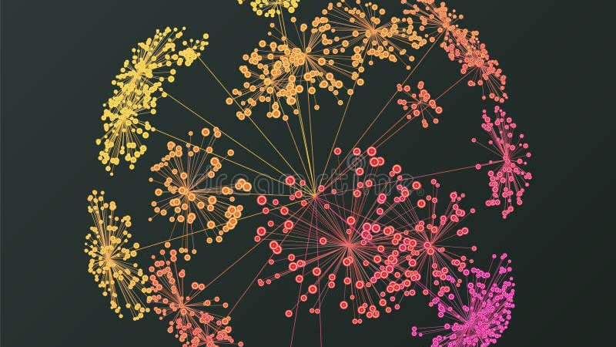
04
UNSUPERVISED LEARNING
Discovering hidden patterns in unlabeled data

Slide 20
04 | UNSUPERVISED LEARNING
Introduction to Unsupervised Learning
Unsupervised learning analyzes unlabeled data to identify patterns, structures, or relationships without predefined targets. No "correct answers" are provided during training.
WHY UNSUPERVISED?
1. Labeling data is expensive and time-consuming
Analogy
Like a child sorting books without labels — grouping by genre based on similarities (size, pictures, text style). The algorithm must discover structure independently.
2. You may not know what patterns exist beforehand
Common Applications
3. Useful for preprocessing and feature learning
Customer segmentation — targeted marketing
Anomaly detection — fraud, cybersecurity
4. Scales naturally with data volume
Exploratory data analysis — pattern discovery
Image compression — reduce color palette
"Unsupervised learning is especially valuable early in ML projects, when teams may not yet know what questions to ask."
20

Slide 21
04 | UNSUPERVISED LEARNING
Types of Unsupervised Learning
Clustering
Dimensionality Reduction
Association Rules
Grouping similar data points into clusters based on distance or similarity measures.
Goal:
Maximize intra-cluster similarity
Minimize inter-cluster similarity
Reducing the number of features while preserving important information.
Goal:
Simplify data for visualization
Faster processing
Remove noise/redundancy
Discovering relationships between variables in large datasets.
Goal:
Find "if X then Y" patterns
Identify co-occurring items
ALGORITHMS
ALGORITHMS
ALGORITHMS
K-Means Clustering
Hierarchical Clustering
DBSCAN
Gaussian Mixture Models
PCA (Principal Component Analysis)
t-SNE
Autoencoders
UMAP
Apriori Algorithm
Eclat
FP-Growth
21

Slide 22
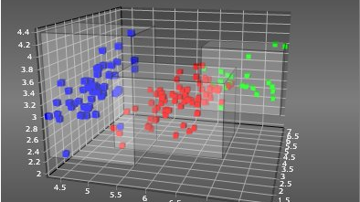
05
K-MEANS CLUSTERING
The most popular clustering algorithm: principles, process, and practice

Slide 23
05 | K-MEANS CLUSTERING
What is K-Means Clustering?
K-Means is an unsupervised clustering algorithm that partitions data into K groups based on similarity. "K" represents the number of clusters.
CLUSTER QUALITY GOALS
High Intra-Cluster Similarity
Key Properties
Data points within the same cluster should be as similar as possible to each other.
Minimizes WCSS — Within-Cluster Sum of Squared distances
Intra-cluster similarity: points in a cluster should be similar
Inter-cluster dissimilarity: different clusters should be distinct
Low Inter-Cluster Similarity
Data points in different clusters should be as dissimilar as possible from each other.
Distance metric: Euclidean distance (default)
Applications
Customer segmentation — group customers by behavior
Image compression — reduce color palette
Document clustering — organize text collections
Anomaly detection — identify outliers
Geographic analysis — location-based grouping
OBJECTIVE FUNCTION
$$WCSS=∑_{i=1}^{K}∑_{x∈C_{i}}∣∣x−μ_{i}∣∣^{2}$$
Where μᵢ is the centroid of cluster Cᵢ. K-Means minimizes this objective.
23

Slide 24
05 | K-MEANS CLUSTERING
The K-Means Algorithm: Step by Step
1
Initialization
ALGORITHM VISUALIZATION
Randomly select K data points as initial centroids (cluster centers).
Step 1: Randomly place K centroids (red stars) in the data space
2
Assignment
Assign each data point to the nearest centroid using Euclidean distance.
3
Update
Step 2: Assign each point to its nearest centroid — clusters form
Recalculate each centroid as the mean of all points in that cluster.
4
Repeat
Step 3: Move each centroid to the mean of its assigned points
Iterate Steps 2-3 until centroids stabilize (convergence) or max iterations reached.
Convergence guarantee: The algorithm always converges, though possibly to a local optimum, not necessarily the global optimum.
Step 4: Repeat until centroids no longer move significantly
Time Complexity: O(n × K × I × d) where n = data points, K = clusters, I = iterations, d = dimensions.
FINAL CLUSTERS REPRESENT NATURAL GROUPINGS
24

Slide 25
05 | K-MEANS CLUSTERING
K-Means: A Worked Example
Example: 8 data points, K = 2 clusters
Iteration 1
Iteration 2
Convergence
Initialize: Random centroids C1, C2
Assign: Each point to nearest centroid
→ Two clusters form
Update: Recalculate centroids as mean of assigned points
→ Centroids move to new positions
Reassign: Points redistributed based on updated centroids
→ Some points may switch clusters
Update: Centroids recalculated again
→ Positions refined
Check: No points change clusters
Check: Centroids stabilize
→ Algorithm stops
Final clusters represent natural groupings in the data
Important: The initial centroid selection significantly impacts the final result. Different random starts may produce different clusters. This is why K-Means++ initialization is recommended — it spreads initial centroids apart for better results.
K-Means++ Improvement
K-Means++ optimizes initialization:
1. First centroid chosen uniformly at random from data points
2. Each subsequent centroid chosen with probability proportional to squared distance from nearest existing centroid
3. Repeat until K centroids selected
25

Slide 26
05 | K-MEANS CLUSTERING
Choosing the Optimal K: The Elbow Method
The Elbow Method is a graphical technique to determine the optimal number of clusters by identifying where adding more clusters provides diminishing returns.
Procedure
1. Run K-Means for K = 1, 2, 3, ..., n
2. Compute WCSS (Within-Cluster Sum of Squares) for each K
3. Plot WCSS vs. K
← ELBOW AT K=3
4. Identify the "elbow" — where WCSS reduction sharply slows
Interpretation
Before the elbow: Adding clusters significantly reduces WCSS → meaningful improvement
After the elbow: Diminishing returns → over-segmentation
Too few clusters: Under-segmentation, missed patterns
Too many clusters: Over-segmentation, less interpretable
Other methods: Silhouette Score (measures cluster quality), Gap Statistic, and Domain Knowledge can also guide K selection.
26

Slide 27
05 | K-MEANS CLUSTERING
K-Means: Challenges & Solutions
<p><span></span></p> | Challenge | Description | Solution
1 | Random Initialization | Random centroids may lead to poor local optima and inconsistent results across runs | Use K-Means++ initialization — selects centroids spread apart
2 | Choosing K | Requires prior knowledge; wrong K produces meaningless clusters | Elbow Method, Silhouette Score, or domain expertise
3 | Sensitivity to Outliers | Outliers can significantly distort centroid positions | Use K-Medoids or preprocess to remove outliers
4 | Spherical Cluster Assumption | Assumes clusters are convex and isotropic; fails on non-convex shapes | Use DBSCAN or Hierarchical Clustering
5 | Feature Scaling | Different feature scales bias distance calculations | Standardize features using StandardScaler (z-score normalization)
27

Slide 28
WEEK 6 | SUMMARY
Supervised vs. Unsupervised: At a Glance
Aspect | Supervised Learning | Unsupervised Learning
Input Data | Labeled (input + output pairs) | Unlabeled (input features only)
Goal | Prediction and classification | Discovery and pattern recognition
Output | Labels or predicted values | Clusters, patterns, reduced dimensions
Evaluation | Accuracy, MSE, F1-score, RMSE | Silhouette score, WCSS, expert review
Key Algorithms | Linear/Logistic Regression, SVM, Decision Trees | K-Means, PCA, DBSCAN, Hierarchical
Human Effort | Requires data labeling (expensive) | Minimal preprocessing needed
When to Use | Known outcomes, labeled data available | Exploring unknown structure, no labels
Modern trend: Semi-supervised learning combines a small labeled dataset with a large pool of unlabeled data, reducing labeling costs while retaining predictive accuracy.
28

Slide 29
WEEK 6 | SUMMARY
Key Takeaways
1
Machine Learning enables systems to learn from data without explicit programming — the foundation of modern AI.
4
The decision boundary separates classes where P(y=1|X) = 0.5. Gradient descent optimizes the cost function.
2
Supervised Learning uses labeled data for prediction tasks — classification (discrete) and regression (continuous).
5
Unsupervised Learning discovers patterns in unlabeled data without predefined targets.
3
Logistic Regression is a classification algorithm using the sigmoid function to output probabilities between 0 and 1.
6
K-Means Clustering partitions data into K clusters by iteratively assigning points and updating centroids.
The Elbow Method helps determine the optimal number of clusters. Understanding these fundamentals is essential for building more advanced ML systems including neural networks and deep learning.
What's Next?
Implement Logistic Regression and K-Means from scratch in Python
Experiment with scikit-learn implementations on real datasets
Explore how these classical methods connect to neural networks and deep learning
29

Slide 30
THANK YOU
Questions & Discussion
Artificial Intelligence — Week 6
Machine Learning: Supervised & Unsupervised Learning
LECTURES 11 — 12

